Slide 1

OBJECT
CONCEPTS
4
Understanding basic object-oriented concepts

Slide 2
1
INTRODUCTION
2
METHODOLOGIES
3
MODELS AND UML
4
OBJECT CONCEPTS
5
ANALYSIS
6
SOFTWARE DESIGN

Slide 3
Goal of Presentation
This presentation will cover
  object and class
  methods and attributes
  abstraction, encapsulation, information-hiding, coupling
  cohesion, inheritance, association
  aggregation, collaboration
  messaging, polymorphism, persistence

Slide 4
What is an Object?
In some way everything can be an object.
In general, an object is a person, place, thing, event, or concept.
Because different people have different perceptions of the same object, what an object is depends upon the point of view of the observer.
  “ … for there is nothing either good or bad, but thinking makes it so.”
  That is, we describe an object on the basis of the features and behaviors that are important or relevant to us.

Slide 5
Abstraction
An object is thus an abstraction.
An object is an “abstraction of something in the problem domain, reflecting the capabilities of the system to keep information about it, interact with it, or both.” (Coad and Yourdon)
Source: Bennett, McRobb, and Farmer, Object-Oriented Systems Analysis and Design (McGraw Hill, 2002), p. 64

Slide 6
Abstraction
An abstraction is a form of representation that includes only what is useful or interesting from a particular viewpoint.
  e.g., a map is an abstract representation, since no map shows every detail of the territory it covers
  "A map is not the territory it represents, but if correct, it has a similar structure to the territory, which accounts for its usefulness" -- Alfred Korzybski
Source: Bennett, McRobb, and Farmer, Object-Oriented Systems Analysis and Design (McGraw Hill, 2002), p. 64

Slide 7

Types of Objects
Objects are usually classified as
  Objects representing physical things
    e.g. students, furniture, buildings, classrooms
  Objects representing concepts
    e.g., courses, departments, loan

Slide 8
Class
We classify similar objects as a type of thing in order to categorize them and make inferences about their attributes and behavior.
  To a child, mommy, daddy, big brother, and aunt Jane are all classified together as people with relatively similar attributes (head, nose, arms) and behaviors (smile, hug, run, etc).
For this reason, a type of object is referred to as a class.
  A general type of thing is a superclass, a special type of thing is a subclass.
Superclass
Person
Subclass
Subclass
Parent
Child

Slide 9
Class and objects
A class is thus a type of thing, and all specific things that fit the general definition of the class are things that belong to the class.
  A class is a "blueprint" or description for the objects.
An object is a specific instance of a class.
  Objects are thus instantiated (created/defined) from classes
☺
☺
Sue
are instances of
Fred
Student
😐
☹
the Student class
Eric
Jane
These student objects
Source: Scott Ambler, The Object Primer (Cambridge University Press, 2001), p.136

Slide 10
Class Members
Attributes/Data
  the things classes "know" (nouns)
  a piece of data or information
  sometimes called data members or member variables or fields
Methods/Operations/Behaviors
  the things classes "do" (verbs)
  These define the operations you can perform for the class.
  Similar to procedures/functions in other programming languages.

Slide 11
Naming classes
Class names are typically nouns.
  The name of a class generally should be one or two words.
Class names are almost always singular (Student, not Students).
  In the real world, you would say “I am a student,” not “I am a students”
In UML, classes are modeled as a rectangle that lists its attributes and methods, or just as a rectangle.
Student
Student
attributes
methods
UML (Unified Modeling Language) is a diagramming notation for describing software systems.
Source: Scott Ambler, The Object Primer (Cambridge University Press, 2001), p.138

Slide 12
UML Class Diagrams
Student
Student
Student
attributes
name
phoneNumber
address
-name: String
-phoneNumber: String
-address: String
methods
enrollCourse()
payTuition()
dropCourse()
getName()
+enrollCourse(): void
+payTuition(): void
+dropCourse(): void
+getName(): String
Student
In UML, you can add/remove detail from your class diagrams

Slide 13
Interfaces
The attributes and methods that a class provides to other classes constitute the class’s interface.
The interface thus completely describes how users of that class interact with the class.
  In Java and C#, methods and attributes are designated using either the public, private or protected keyword.

Slide 14



Real-world Interface & Implementation
Requesting object
Interface
Implementation
Source: Matt Weisfeld, The Object-Oriented Thought Process (Sams, 2000), p.22

Slide 15
Encapsulation
Perhaps the most important principle in OO is that of encapsulation (also known as information hiding or implementation hiding).
  This is the principle of separating the implementation of an class from its interface and hiding the implementation from its clients.
  Thus, someone who uses a software object will have knowledge of what it can do, but will have no knowledge of how it does it.
Source: Meiler Page-Jones, Fundamentals of Object-Oriented Design in UML(Addison-Wesley, 2000), p.12-4

Slide 16
Encapsulation
Benefits
  Maximizes maintainability
    making changes to the implementation of a well encapsulated class should have no impact on rest of system.
  Decouples content of information from its form of representation
    thus the user of an object will not become tied to format of the information.
Source: Meiler Page-Jones, Fundamentals of Object-Oriented Design in UML(Addison-Wesley, 2000), p.12-4

Slide 17
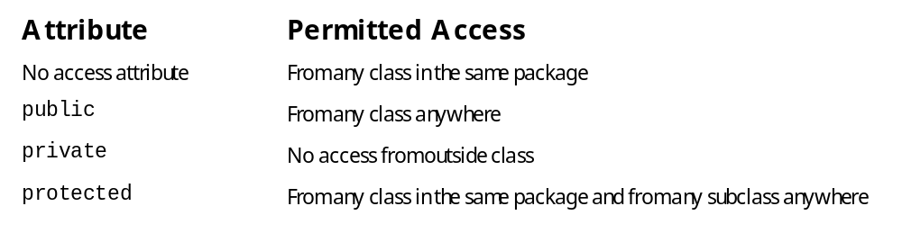
Encapsulation
Encapsulation is implemented through access protection.
  Every class, data member and method in a Java or C# program is defined as either public, private, protected or unspecified.

Slide 18
Variable Scope
class 1
class 2
private variable A
private variable X
private variable B
public variable Y
public variable C
public variable Z
...
...

Slide 19
Scope of Member Variables
class ScopeClass
{
private int aPrivate = 1;
int aUnknown = 2;
public int aPublic = 3;
}
class ScopeTest
{
public static void main(String[] args)
{
ScopeClass aScope = new ScopeClass();
System.out.println("Scope Test");
System.out.println("aPrivate=" + aScope.aPrivate);
System.out.println("aUnknown=" + aScope.aUnknown);
System.out.println("aPublic=" + aScope.aPublic);
}
}
Generates a compile error

Slide 20
Review: Classes
Classes are the most fundamental structural element in Java or C#
  Every program has at least one class defined.
  Data member declarations appear within classes.
  Methods appear within classes.
  statements appear within methods and properties.
class
data member declarations
method
statement
method
statement
statement
statement

Slide 21
Class Definitions
class definition
public class Rectangle {
public double lowerLeftX,lowerLeftY;
public double upperRightX,lowerRightY;
public double width() {
return upperRightX - lowerLeftX;
}
public double height() {
return upperRightY - lowerLeftY;
}
public double area() {
return width() * height();
}
}
data member declaration
method definition
method implementation
method definition
method implementation
method definition
method implementation
...
Call or invoking the width and height methods defined above.

Slide 22
Types of members
Two types of members (data members and methods):
  static or class members
    a member that is shared by all objects of that class
    it is called a class member because it belongs to the class, not to a given object.
    It is called a static member because it is declared with the static keyword.
  instance members
    Each instance/object of the class will have a copy of each instance member.

Slide 23
Members in a class definition
numPersons
public class Person {
// class variables
static int numPersons;
// instance variables
String name;
String phone;
int age;
}
Shared between all objects
name
phone
age
Each object will get its own copy
Person objects
Created later by new statement
name
phone
age
Source: Ivor Horton, Beginning Java 2 (Wrox)

Slide 24
Instance variables in a class definition
...
public class Person {
// instance variables
String name;
int age;
}
...
Person employee;
employee = new Person;
employee.name = "Karl Marx";
employee.age = 56;
employee
Creates a memory location to hold reference (memory address) to an object of type employee. No object is created and no memory allocated for object.
1.
2.
2.
Creates employee object in memory and sets employee to reference it.
name
3.
age
name
Karl Marx
age
56
Person object
Source: Ivor Horton, Beginning Java 2 (Wrox)
Person object

Slide 25
Instance variables in a class definition
...
public class Person {
// instance variables
String name;
int age;
}
...
Person employee = new Person;
Person boss = new Person;
employee.name = "Karl Marx";
employee.age = 56;
boss.name = "Adam Smith";
boss.age = 44;
Creates memory location to reference object and creates employee object in memory and sets employee to reference it.
employee
name = Karl Marx
age = 56
Person objects
name = Adam Smith
age = 44
boss

Slide 26
Some Scope Combinations
public static
  Static variable, that is shared between all instances, and that is available to other classes.
private static
  Static variable, that is shared between all instances, and that only available within its class.
public
  Instance variable (each instance will have a copy), that is available to other classes.
private
  Instance variable (each instance will have a copy), that is only available within its class.
final (java) / const (C#)
  Indicates that the value in the variable can not be changed (i.e., it is a constant).

Slide 27
Some Scope Combinations
class ScopeClass {
// data members
private static int aPrivateStatic = 1;
public static int aPublicStatic = 2;
private final static int ONECONSTANT = 10;
public final static int TWOCONSTANT = 20;
private int aPrivateInstance = 3;
public int aPublicInstance = 4;
}
aPrivateStatic = 1
aPublicStatic = 2 ⇨ 2000 ⇨ 4000
ONECONSTANT = 10
class ScopeTest {
public static void main(String[] args) {
ScopeClass xScope = new ScopeClass();
ScopeClass yScope = new ScopeClass();
xScope.aPublicInstance = 77;
yScope.aPublicInstance = 44;
xScope.aPublicStatic = 2000;
yScope.aPublicStatic = 4000;
System.out.println(xScope.aPublicInstance);
System.out.println(xScope.aPublicStatic);
System.out.println(yScope.aPublicInstance);
System.out.println(yScope.aPublicStatic);
System.out.println(ScopeClass.aPublicStatic);
System.out.println(ScopeClass.TWOCONSTANT);
}
}
TWOCONSTANT = 20
xScope
aPublicInstance=77
aPrivateInstance=3
yScope
aPublicInstance=44
aPrivateInstance=3

Slide 28
Accessing data members directly
public class Employee {
// data members
public String name;
public double salary;
public static int numEmployees;
}
...
Employee boss = new Employee("Randy");
boss.salary = 50000.0
Employee.numEmployees = 44;
...
Is this allowed?

Slide 29
Accessing data members directly
Direct variable access of data members from other classes is allowed unless the variable is private.
  e.g., boss.salary
However, it is strongly discouraged.
  With direct access, the class loses its ability to control what values go into an data member (i.e., no longer do we have encapsulation).
    e.g., in previous example, user could enter a negative value for salary.

Slide 30
Accessors and Mutators
In Java, provide accessor and mutator methods for retrieving data values and for setting data values
  e.g., getSalary() and setSalary()
  To prevent outside direct variable access, use the private modifier.
Mutators often need error checking (indeed this is their whole purpose).
private double salary;
public void setSalary(double newSalary) {
salary = newSalary;
}
public double getSalary() {
return salary;
}
public void setSalary(double newSalary) {
if (newSalary >= 0)
salary = newSalary;
else
throw new Exception("Illegal salary in setSalary");
}

Slide 31
Properties
In C#, there is a language feature called properties which are used instead of accessors/mutators.
private double salary;
public double Salary {
get { return salary; }
set { salary = value;
}
…
double x = Salary;
Salary = 50.0;

Slide 32
Conventions for Data Members
While not necessary, it will make your class’s code more readable and comprehensible to use a naming convention for data members.
  Developers often add an underscore (_) or m_ as a prefix or suffix.
  e.g., _salary
public class Employee {
// data members
private double _salary;
// properties
public double Salary {
get { return _salary; }
set { _salary = value;
}
}

Slide 33
Constructors
When an object of a class is created (via new), a special method called a constructor is always invoked.
  You can supply your own constructor, or let the compiler supply one (that does nothing).
  Constructors are often used to initialize the instance variables for that class.
Two characteristics:
  constructor method has same name as the class.
  Constructor method never returns a value and must not have a return type specified (not even void).
Source: Ivor Horton, Beginning Java 2 (Wrox), p. 177.

Slide 34
Constructor
public class Person {
// data members
public String _name;
public String _phone;
public int _age;
// class constructor
public Person()
{
_age = -1;
}
// class methods
// instance methods
}
...
Person employee = new Person();
Person boss = new Person();
...
Each time a Person object is created, the class constructor is called (and as a result, employee._age and boss._age is initialized to -1)

Slide 35
Multiple Constructors
You can supply more than one constructor method to a class.
  Typically done to provide users with alternate ways of creating an object.
This is called overloading (and can be done with method and constructors)
public class Person {
// instance variables
String _name;
int _age;
// class constructors
public Person() {
_age = -1;
}
public Person(int age) {
_age = newAge;
}
public Person(int age, String name) {
_age = age;
_name = name;
}
}
...
Person employee = new Person;
Person janitor = new Person(45);
Person boss = new Person(30, "Fred");
...

Slide 36
Invoking another Constructor (Java)
public class Person {
...
public Person(int age) {
_age = age;
}
public Person(int age, String name) {
this(age);
_name = name;
}
public Person(int age, String name, String address) {
this(age, name);
_address = address;
}
}

Slide 37
Invoking another Constructor (C#)
public class Person {
...
public Person(int age) {
_age = age;
}
public Person(int age, String name) : this(age) {
_name = name;
}
public Person(int age, String name, String address) : this(age,name) {
_address = address;
}
}

Slide 38
Static Initialization
Constructors can only initialize instance data members.
To initialize static data members, you must use either:
  When they are declared.
    E.g.
    public class Sample {
    private static int _count = 0;
  Within a static initialization block (Java)
    Necessary when static variable must invoke a method
    E.g.
    public class Sample {
    private static int _count;
    private static LookupTable _table;
    static {
    _count = 0;
    _table = LoadTableFromFile();
    }
  Within a static constructor (C#)
    E.g.
    public class Sample {
    private static int _count;
    private static LookupTable _table;
    static Sample() {
    _count = 0;
    _table = LoadTableFromFile();
    }

Slide 39
Method Overloading
There are situations where you need a method that does similar things but accept different lists of arguments.
Java and C# allow you to overload a method definition so that the method can accept a different number of arguments.
  That is, they allow multiple methods to have the same name, as long as those methods have different lists of arguments.
  It makes a method more flexible
Method overloading is an important part of object-oriented development
  Subclasses can overload methods defined in a superclass.
class Calculator {
public int add(int a, int b) {
return a + b;
}
public double add(double a, double b) {
return a + b;
}
}
...
Calculator calc = new Calculator();
int a = calc(3,5);
double b = calc(34.56,342.45);
...

Slide 40
Class Relationships
Classes do not exist by themselves themselves, but exist in relationships with other classes.
Kinds of relationship
  Generalization (Inheritance)
  Aggregation
  Association
  Dependency

Slide 41
Generalization Relationship
Classification of objects is hierarchic in nature.
A subclass is said to specialize its superclass(es) by including only certain of the superclass features.
A superclass generalizes its subclasses by including all those features that are general to all the subclasses.
More generalized (superclasses)
Person
Employee
Customer
Paid weekly
Paid monthly
Paid hourly
More specialized (subclasses)
Source: David William Brown, An Intro to Object-Oriented Analysis (Wiley, 2002), p. 227-230
Source: Bennett, McRobb, and Farmer, presentation for Object-Oriented Systems Analysis and Design

Slide 42
Features of generalization
The features of generalization, in terms of OO, are:
  Inheritance
  Transitive nature of inheritance (polymorphism)

Slide 43
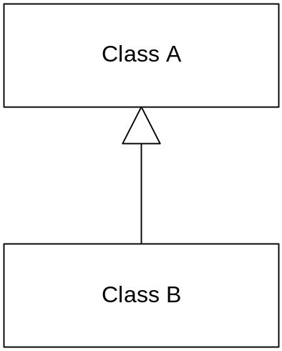
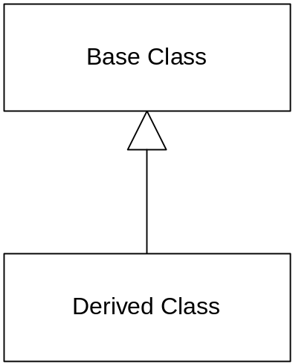
Inheritance
Inheritance is the facility by which a class A has implicitly defined upon it each of the attributes and operations of another class B.
  A is a superclass of B
  B is a subclass of A
Inheritance enables one to reuse existing code by taking advantage of similarities between classes.
Superclass
The UML modeling notation for inheritance
Subclass

Slide 44
Inheritance
SupportStaff
Superclass
name
phoneNumber
address
hourlyWage
Employee
name
phoneNumber
address
WageContract()
CalculateTax()
PayTuition()
DropCourse()
CalculateTax()
OR
Professor
SupportStaff
Professor
name
phoneNumber
address
salary
hourlyWage
salary
WageContract()
TeachCourse()
DevelopCourse()
TeachCourse()
CalculateTax()
DevelopCourse()
Subclasses
Both the SupportStaff and Professor classes inherit the methods and attributes of the Employee class.

Slide 45
Inheritance
Person
can be a
is a
Student

Slide 46
Inheritance
Inheritance is the representation of an is a, is like, is kind of relationship between two classes.
  e.g., a Student is a Person, a Professor is kind of a Person
  is a relationships are best.
With inheritance, you define a new class that encapsulates the similarities between two classes
  e.g., for Student and Professor, the new class was Person, which contains the attributes and methods contained in both.

Slide 47
Inheritance Tips
Look for similarities
  whenever you have similarities between two or more classes (either attributes or methods), you probably have an opportunity for inheritance.
Look for existing classes
  when you create a new class, you may already have an existing class to which it is similar. Perhaps you can inherit from this existing class and code just the differences.
Follow the sentence rule
  It should make sense to use the classes in one of the sentences:
  "a X is a Y", "a X is a kind of Y", or "a X is like a Y"
Source: Scott Ambler, The Object Primer (Cambridge University Press, 2001), p.148-9

Slide 48
Inheritance Tips
Avoid implementation inheritance
  i.e., don't apply inheritance just to use a feature of another class if the sentence rule does not apply.
  Be cautious of "is like a" applications of inheritance (more on this later).
Inherit everything
  the subclass should inherit all features of its superclass.
  i.e., you shouldn't say "X is a Y, except for …"
Source: Scott Ambler, The Object Primer (Cambridge University Press, 2001), p.148-9

Slide 49
Inheritance Exercise
Create a subclass hierarchy using inheritance
  You will need to create the superclasses
Penguin
Sparrow
Duck
Tuna
Salmon

Slide 50
Inheritance Exercise
Create a vehicle subclass hierarchy using inheritance
  You will need to create the superclasses.
Horse-drawn Vehicle
Person-Powered Vehicle
Gas-Powered Vehicle
Wind-Powered Vehicle
Electric-Powered Vehicle
Sailboat
Car
Bicycle
Skateboard
Chariot
Motorcycle
Hang glider
Truck
Carriage
LRT

Slide 51
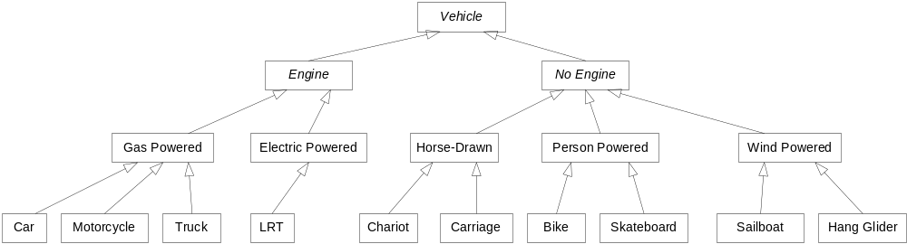
Inheritance Exercise

Slide 52
Inheritance in Java
Person
Student
Professor
public class Person
{
// data members and methods here
}
public class Student extends Person
{
}
public class Professor extends Person {
}

Slide 53
Inheritance in C#
Person
Student
Professor
public class Person
{
// data members and methods here
}
public class Student : Person
{
}
public class Professor : Person {
}

Slide 54
public class Employee {
private String _employeeName;
private String _employeeDept;
private int _yearsService;
public Employee(String name, String dept, int years) {
_employeeName=name; _employeeDept=dept; _yearsService=years;
}
public String getName() { return _employeeName; }
public String getDept() { return _employeeDept; }
public int getYearsService() { return _yearsService; }
public double getHolidays() { return 20.0; }
}
public class Technician extends Employee {
private int m_serviceCalls;
public Technician(String name, String dept, int years) {
super(name, dept, years);
}
public int getServiceCalls() { return m_serviceCalls; }
}
Invokes constructor from superclass
public class Manager extends Employee {
public Manager(String name, String dept, int years) {
super(name, dept, years);
}
public double getHolidays() { return 30.0; }
}
overrides

Slide 55
Using the Classes
class EmployeeTest
{
public static void main(String[] args)
{
Employee fred = new Employee("Fred", "IS", 15);
Manager dave = new Manager("Dave", "Acct", 25);
Technician sue = new Technician("Sue", "IS", 10);
System.out.println(fred.getName()+ fred.getHolidays());
System.out.println(dave.getName() + dave.getHolidays());
System.out.println(sue.getName() + sue.getHolidays());
}
}
output
Fred20.0
Dave30.0
Sue20.0

Slide 56
Abstract and Concrete classes
An abstract class is one that can not have objects instantiated from it.
  In diagrams, an abstract class is indicated via italics
  When italics are impractical (e.g., whiteboards, blackboards), then use the stereotype {abstract}
A concrete class is one that can have objects instantiated from it.
{abstract}
Window
Person
Student
Professor
PopUpWindow
DialogWindow
FormWindow

Slide 57
Abstract and Concrete classes
Abstract classes allow you to do either or both:
  Specify the required interface of concrete classes that will be implemented by the concrete subclasses.
  Specify the implementation of common functionality (i.e., implement members).

Slide 58
Abstract and Concrete classes
For example, let's imagine that for some health management software for a veterinarian, we've come up with the following concrete objects, which will correspond to the actual animals coming into the vets. Now try to group them under one or more abstract classes.
Dog
Cat
Mouse
Rabbit
Iguana
Geeko

Slide 59
Abstract and Concrete class example
Animal
Mammal
Reptile
Mouse
Dog
Rabbit
Cat
Iguana
Geeko
Mammal and Animal are abstract classes, since it wouldn't be a mammal that comes in to get treated, but a concrete kind of mammal, such as a dog or cat. That is, it is unlikely that the veterinarian wouldn't know what kind of mammal or animal he or she was treating.

Slide 60
Abstract Methods
Methods can also be abstract.
Java and C# let you define a method or method without implementing it by declaring the method with the abstract modifier.
  This is useful for a superclass, in that you want the subclass to inherit the method signature (i.e., the interface), but the subclasses implement the method.
Only instance methods can be abstract
  That is, static methods cannot be abstract
if a class contains an abstract method, then the class itself must also be declared abstract.

Slide 61
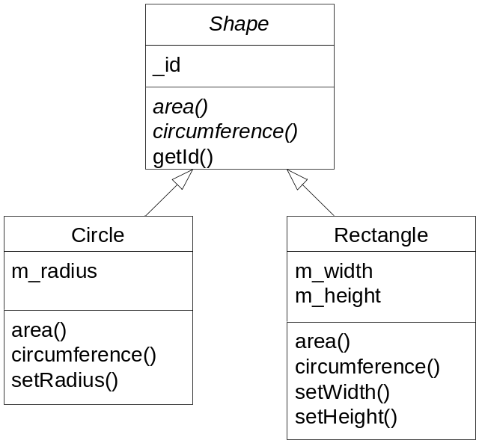
Abstract Class Example (java)
public abstract class Shape {
...
public abstract double area();
public abstract double circumference();
public int getId() { return _id; };
}
Note!
public class Circle extends Shape {
private double m_radius;
...
public double area() {
return 3.14159 * m_radius * m_radius;
}
public double circumference() {
return 2.0 * 3.14159 * m_radius;
}
...
}
public class Rectangle extends Shape {
private double m_width, m_height;
...
public double area() {
return m_width * m_height;
}
public double circumference() {
return 2.0 * (m_width + m_height);
}
...
}

Slide 62
Abstract Class Example (C#)
public abstract class Shape {
...
public abstract double area();
public abstract double circumference
{
get ;
}
public int getId() { return _id; };
}
Note that in C# abstract properties have a different syntax.
public class Circle extends Shape {
private double _radius;
...
public override double area() {
return 3.14159 * _radius * _radius;
}
public override double circumference {
get {
return 2.0 * 3.14159 * _radius;
}
}
...
}
Note as well the necessity of adding the override key word to the concrete implementation.

Slide 63
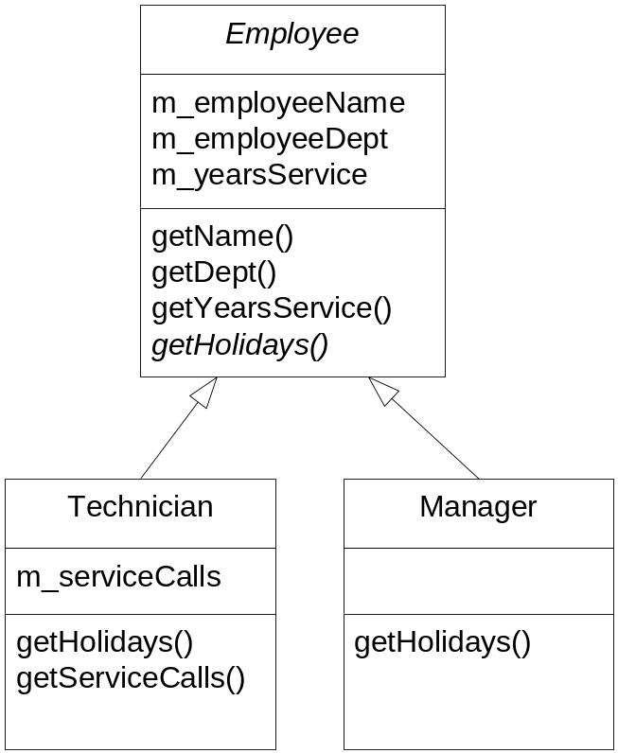
Another Abstract Class Example
abstract class
concrete methods
abstract method
implementation

Slide 64
Abstract Class and Method Example
public abstract class Employee {
...
public abstract double getHolidays();
...
}
public class Technician extends Employee {
...
public getHolidays() { return 15.0; }
...
}
public class Manager extends Employee {
...
public getHolidays() { return 30.0; }
...
}

Slide 65
Using the Classes
class EmployeeTest
{
public static void main(String[] args)
{
//Employee fred = new Employee("Fred", "IS", 15);
Manager dave = new Manager("Dave", "Acct", 25);
Technician sue = new Technician("Sue", "IS", 10);
//System.out.println(fred.getName()+ fred.getHolidays());
System.out.println(dave.getName() + dave.getHolidays());
System.out.println(sue.getName() + sue.getHolidays());
}
}
These lines will give compile error if uncommented.
output
Dave30.0
Sue15.0

Slide 66
Substitutability
Substitutability refers to the principle that subtypes must be substitutable for their supertypes.
  That is, if I write code assuming I have the superclass, it should work with any subclass.
  e.g., if I wrote code assuming I have a Person object, it should work even if I have a Student or Professor object
Also referred to as the Liskov Substitution Principle (LSP)
Substitutability is possible due to the polymorphic nature of inheritance.
Person
Student
Professor
Source: Martin Fowler, UML Distilled, 3rd Edition (Addison-Wesley, 2003), p.45-6.

Slide 67
Polymorphism
Polymorphism is:
  the ability to select different methods according to the actual type of an object.
  the ability to manipulate objects of distinct classes using only the knowledge of their shared members.
It allows us to write several versions of a method in different classes of a subclass hierarchy and give them all the same name.
The subclass version of an attribute or method is said to override the version from the superclass.
Shape
setWidth()
setHeight()
getArea()
Rectangle
Triangle
getArea()
getArea()
Source: David William Brown, An Intro to Object-Oriented Analysis (Wiley, 2002), p. 235

Slide 68
Polymorphism
Shape
setWidth()
setHeight()
getArea()
Rectangle
Triangle
getArea()
getArea()
public class Shape {
double width, height;
public abstract double getArea();
public void setWidth(double newWidth) {
width = newWidth;
}
public void setHeight(double newHeight) {
height = newHeight;
}
}
public class Rectangle extends Shape {
public double getArea() {
return (width * height);
}
}
public class Triangle extends Shape {
public double getArea() {
return (0.5 * width * height);
}
}
...
Rectangle myRect = new Rectangle();
myRect.setWidth(5);
myRect.setHeight(4);
System.out.println myRect.getArea();
...

Slide 69
Polymorphism and Substitutability
Polymorphism allows us to program in a way consistent with LSP.
  That is, I write code assuming I have the superclass, it should work with any subclass.
...
Shape myRect = new Rectangle();
Shape myCircle = new Circle();
...
myRect.setWidth(50);
myRect.setHeight(100);
myCircle.setRadius(45);
...
System.out.println( myRect.area() );
System.out.println( myCircle.area() );
...

Slide 70
Polymorphism and Substitutability
...
Rectangle myRect = new Rectangle();
Circle myCircle = new Circle();
...
myRect.setWidth(50);
myRect.setHeight(100);
myCircle.setRadius(45);
...
print(myRect);
print(myCircle);
...
private void print(Shape s)
{
System.out.println("Id=" + s.getId() );
System.out.println("Area=" + s.area() );
}

Slide 71
Single and multiple inheritance
When a class inherits from only one other class, this is called single inheritance.
When a class inherits from two or more classes, this is called multiple inheritance.
  Most OO languages do not support multiple inheritance (Java, C#, Smalltalk do not, but C++ does).
Person
Bird
Lizard
Student
Professor
Dragon
Single Inheritance
Multiple Inheritance
Source: Scott Ambler, The Object Primer (Cambridge University Press, 2001), p.150-1

Slide 72
Java and C# Interfaces
Sometimes we may want a class to inherit from more than one class. Given, however, that Java and C# do not allow multiple inheritance, what can we do?
  we can use an interface for an indirect way to achieve multiple inheritance.
An interface contains only abstract methods and/or constants (no data members).
  In other words, an interface is even more abstract than an abstract class.
An interface thus specifies the required interface that will be implemented by the concrete subclasses.
  It requires another class to implement the methods of the specification.
An interface is not part of a class hierarchy.
  That is, unrelated classes can implement the same interface.
  A class can implement more than one interface.

Slide 73
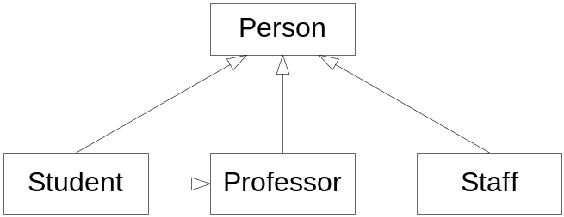
Interface Example
A university system has a Student, a Professor, and a SupportStaff classes.
  Students pay tutition, register in courses, receive grades, etc
  Professors teach course, pick textbooks, supervise students, attend department meetings, pay union dues, etc
  Support Staff answer phones, clean the floors, fix computers, etc.
All three are subtypes of the Person supertype.
  Persons have names, addresses, birthdays, etc
However, it is possible that a Student may teach a course (and then pick textbooks), but not supervise other students, attend department meetings, or pay dues.
✗
This isn’t right: No multiple inheritance allowed.
As well, this isn’t right because a Student is not always a type of Professor

Slide 74
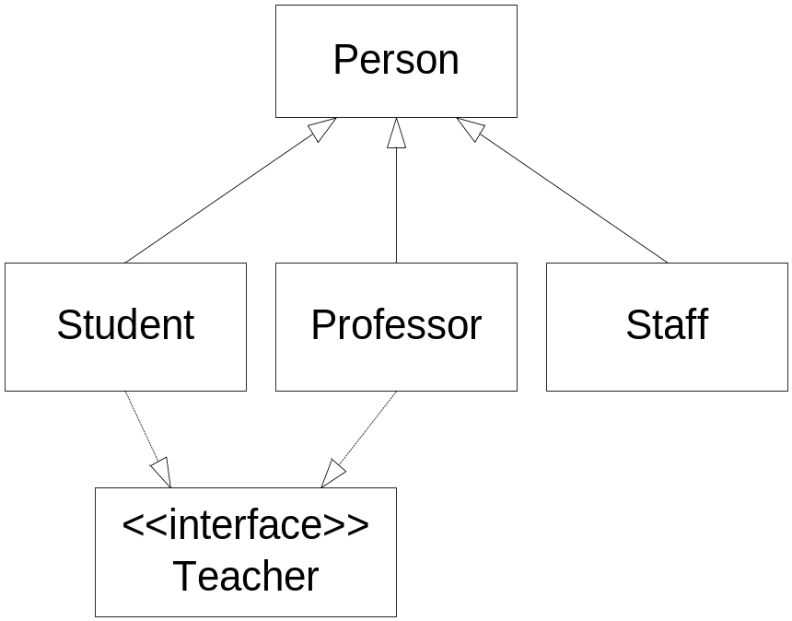
Solution: Use an Interface
Create an interface usable by both the Professor and Student classes.
The methods pertaining to the shared role of Teacher can then be placed in the interface.

Slide 75
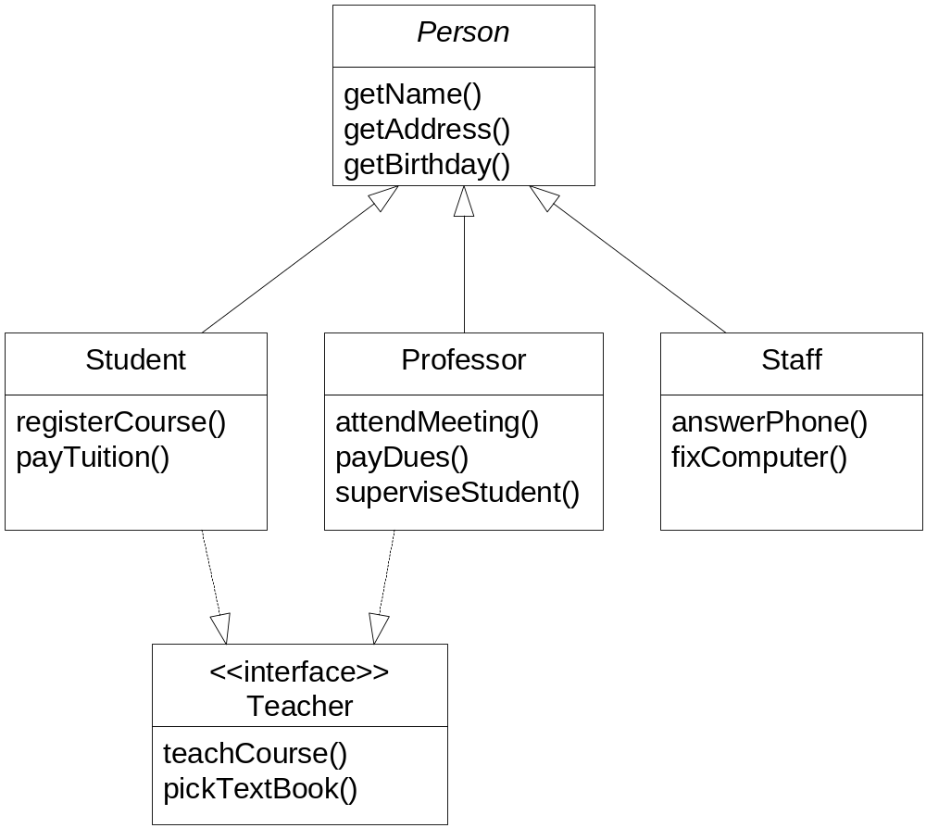
Solution: Use an Interface

Slide 76
Implementing Interfaces (Java)
public interface Teacher
{
public void teachCourse();
public void pickTextBook();
}
class Professor extends Person implements Teacher
{
public void teachCourse() {
...
}
public void pickTextbook() {
...
}
// other methods here
...
}
class Student extends Person implements Teacher
{
public void teachCourse() {
...
}
public void pickTextbook() {
...
}
// other methods here
...
}

Slide 77
Implementing Interfaces (C#)
interface Teacher
{
void teachCourse();
void pickTextBook();
}
Note that in C# interfaces (and methods inside them) are implicitly declared as public.
Note that in C# implementing interfaces uses same syntax as inheritance.
class Professor extends Person : Teacher
{
public void teachCourse() {
...
}
public void pickTextbook() {
...
}
// other methods here
...
}
Note that unlike abstract C# methods/properties, when implementing interfaces there is no need for override keyword.

Slide 78
Sealed Classes (C#)
In C#, you can define a class to be sealed.
  This means that you can never derive classes from it.
  Are typically used when creating a framework of classes to be used by other unknown developers.
    Sometimes subclassing an existing class might cause strange behavior in the base class (if not expecting subclassing).
public sealed class Shape {
…
}

Slide 79
Two Types of Inheritance
there are two types of inheritance:
  Implementation inheritance
  Interface inheritance

Slide 80
Two Types of Inheritance
...
Person s = new Professor();
Person p = new Student();
...
System.out.println( s.getName() );
System.out.println( p.getName() );
...
Implementation inheritance
...
Teacher t = new Professor();
Teacher t = new Student();
...
s.teachCourse();
t.teachCourse();
...
Interface inheritance

Slide 81

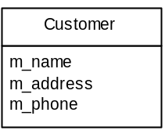


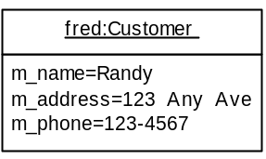
Digression on UML Class & Object Notation
Customer
Name compartment
m_name
Attribute compartment
m_address
m_phone
getName()
Operation compartment
getPhone()
stereotype
Objects

Slide 82
UML Attribute Compartment
visibility name multiplicity: type=initialValue
optional
mandatory
optional
Customer
-m_name
-m_address
-m_phone: String
-m_age:int=0
+Children[]
#salary
static attribute
+numCustomers
+ public visibility
- private visibility
# protected visibility

Slide 83
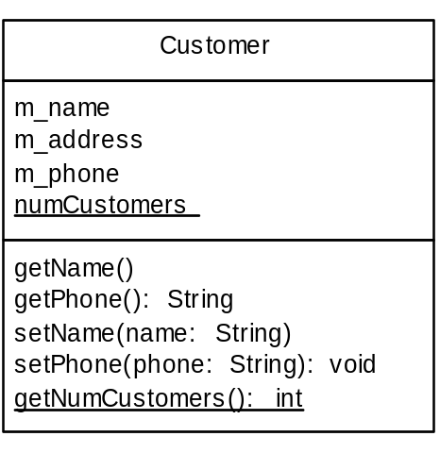
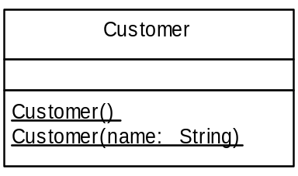
UML Operation Compartment
visibility name ( parameterName: parameterType, ...): returnType
optional
mandatory
optional
optional
constructors

Slide 84
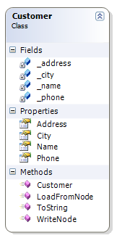


UML Tools
Some commercial UML tools modify the look of standard UML in order to make it “easier” to understand.

Slide 85
Generalization Exercise
Create a subclass hierarchy using inheritance
  There is a problem here in this exercise. Can you find it?
Car
Engine
Car Body
Chassis
Carburetor
Piston
Roof
Fender

Slide 86
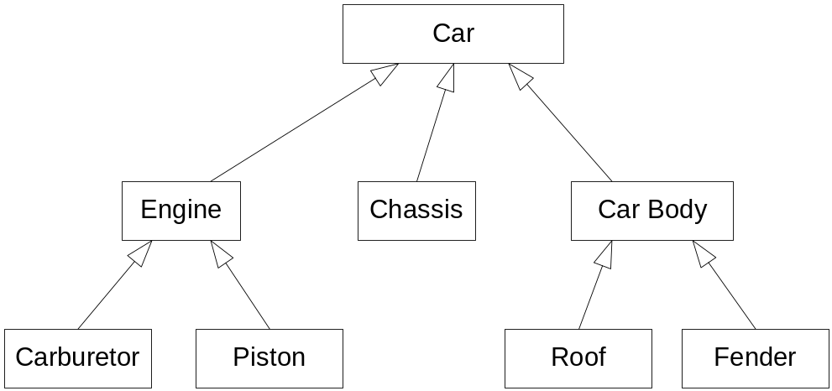
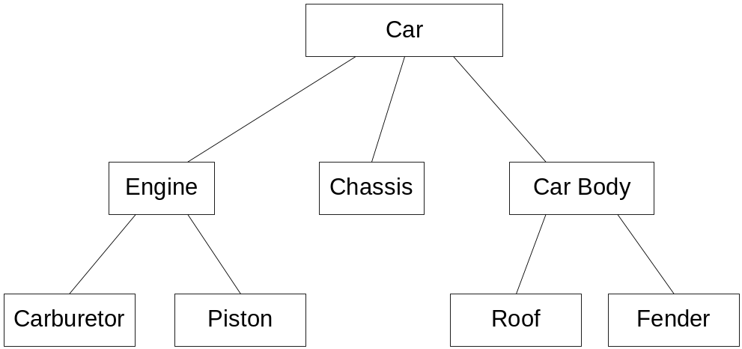
Generalization Exercise ??
✗
This isn’t correct. Why not?
✓
This is correct. Why?
This is a whole-part hierarchy, not a generalization-specialization hierarchy.

Slide 87
Aggregation Relationship
Aggregation is a relationship between two classes where the instances of one class are in some way parts, members, or contents of the instances of the other.
That is, two classes have a “has a” and “part of” relationship.
  e.g. a car has a steering wheel; a steering wheel is part of a car.
Two varieties
  Whole-Part (or simply regular aggregation)
  Composition (sometimes called strong aggregation).
    Each part is associated to only one whole
    A part cannot exist by itself; that is, it can only exist as part of the whole.
      E.g, in a medical system, Arms and Legs and Heads may be separate classes, but would be in a composition aggregation relationship with a Body class.

Slide 88
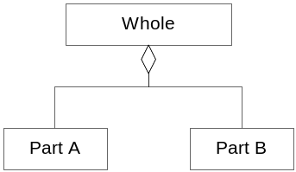
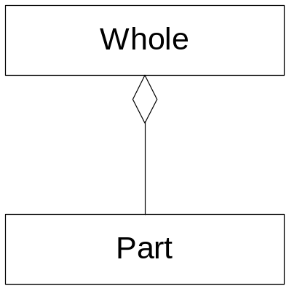
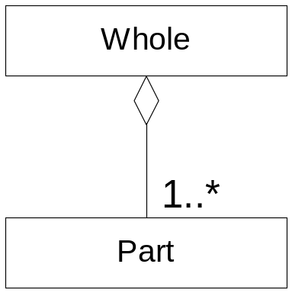
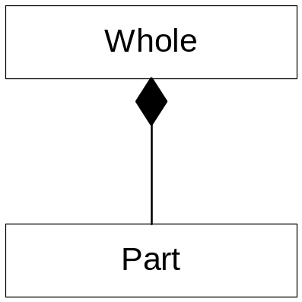
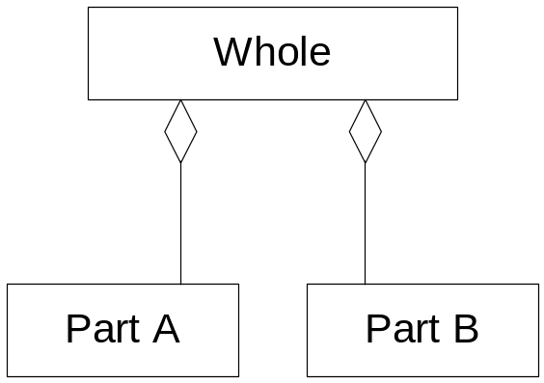
Diagramming Aggregation
Filled diamond indicates composition.

Slide 89
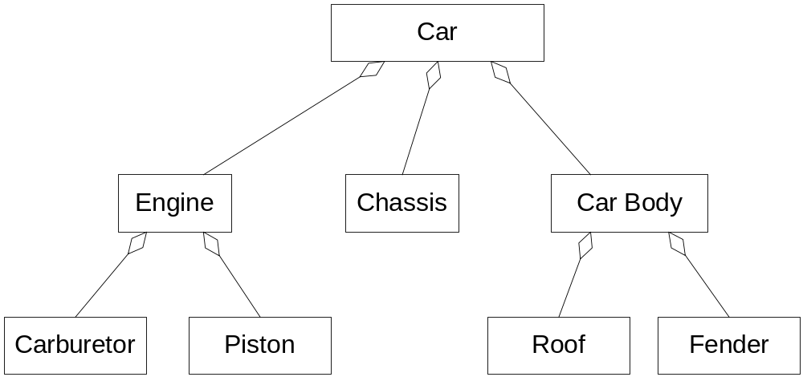
Diagramming Aggregation
1
1
1
1
1
1
1
1..*
1..*
1
4

Slide 90
Aggregation Tips
Apply the sentence rule
  It should make sense to say “the part IS PART OF the whole”
It should be a part in the real world
You should be interested in the part
  e.g., a system for an aircraft maintenance system would be interested in the fact that engines as part of the whole plane, but an air traffic control system would only be interested in the whole plane, not the parts.
Show multiplicity
Could be ignored
  Some authors are now suggesting that aggregation be replaced simply with association.
Source: Martin Fowler, UML Distilled, 3rd Edition (Addison-Wesley, 2003), p.45-6.
Source: Scott Ambler, The Object Primer (Cambridge University Press, 2001), p. 160

Slide 91
Association Relationship
In the real word, objects have relationships, or associations, with other objects.
  e.g., students TAKE courses, professors GRADE students, lions EAT antelopes, etc.
Source: Scott Ambler, The Object Primer (Cambridge University Press, 2001), p.152-3

Slide 92
Association Relationship
An association is a structural or logical connection between classes.
  Association describes possible links between objects.
  Associations are assumed to be bidirectional (both classes know about each other)
Class A
association name
Class B
Student
takes
Course
Employee
holds
Position
Source: Scott Ambler, The Object Primer (Cambridge University Press, 2001), p.152-3

Slide 93
Association Exercise
Describe the associations between the following objects via a diagram.
Student
Course
Professor
Classroom

Slide 94
Association Exercise
Student
takes
Course
is in
Classroom
teaches
Professor

Slide 95
Association Adornments
We can add these optional adornments to our association diagram:
  The name that indicates the name of the relationship, with an optional triangle that points in the direction you should read the name.
  The cardinality (how many) and
  Optionality (is it required or optional) of an association
  The roles that a class may play in an association

Student
takes
Course

Thus, a Student, in her role as a student, takes a Course.
A Student, in her role as a teaching assistant, assists with a Course.
Student
takes
Course
student
teaching assistant

assists with

Slide 96
Multiplicity
UML combines cardinality and optionality into single concept of multiplicity.
Indicator Meaning
0..1 zero or one
1 one only
0..* zero or more
1..* one or more
n only n (where n >1)
0..n zero to n (where n > 1)
1..n 1 to n (where n > 1)
Class A
Cardinality A
label
Cardinality B
Class B
0..*

1..*
Student
takes
Course

Slide 97
Association Exercise
Add multiplicity indicators to your association diagram
Student
takes
Course
is in
Classroom
teaches
Professor

Slide 98
Association Exercise
Student
takes
is in
0..*
1..*
Course
0..*
1
Classroom
0..*
teaches
1..*
Professor

Slide 99
Implementing Associations
Associations are implemented through a combination of attributes and methods.
  e.g., Student TAKES a Course
  e.g., Student class might have addCourse and removeCourse methods, with a corresponding courses array or vector list to keep track of the courses a student is taking
  Likewise, the Course class might also have addStudent and removeStudent methods.
Source: Scott Ambler, The Object Primer (Cambridge University Press, 2001), p.157-8

Slide 100
Implementing Bidirectional Associations
Course
is in
0..*
1
Classroom
class Course
{
private String _name;
private String _number;
private Classroom _room;
...
public void setClassRoom(Classroom r)
{
_room = r;
r.AddCourse(this);
}
...
}
class Classroom
{
private String _roomNum;
private Collection _courses;
...
public AddCourse(Course c) {
_courses.add(c);
}
...
}

Slide 101
Bidirectional associations
In a bidirectional association, both objects in the relationship are linked to each other.
  In previous example, both course and classroom had association to the other.

Slide 102
Bidirectional associations
Bidirectional associations are more difficult to implement (since you need to keep them synchronized without circularity).
class Course {
private Classroom _room;
...
public void setClassRoom(Classroom r)
{
_room = r;
r.AddCourse(this);
}
...
}
class Classroom
{
private String _roomNum;
private Collection _courses;
...
public AddCourse(Course c) {
_courses.add(c);
c.setClassRoom(this);
}
...
}
Example of circular association

Slide 103
Unidirectional associations
Unidirectional associations are usually preferable.
    They contain fewer dependencies between classes and are thus easier to implement and maintain.

Slide 104
Unidirectional associations
In UML, this is referred to as the navigability of the relationship
1
Course
is in
Classroom
class Course {
private Classroom _room;
...
public void setClassRoom(Classroom r)
{
_room = r;
}
...
}
class Classroom
{
private String _roomNum;
...
}
Example of unidirectional association
NOTE: Classroom "knows" nothing of the Course class

Slide 105
Navigability
Navigability refers to ability to traverse from object of one class to an object of another class.
Source: Arlow and Neustadt, UML and the Unified Process (Addison-Wesley, 2002), p. 154-5.

Slide 106
Navigability
Means messages can only be sent in the direction of the arrow.
Thus, a Product object does not contain an Order link, but an Order object does contain a collection of Product links.
not navigable
Order
1
*
Product
navigable
Order
1
*
Product
If no arrows, then the relationship is bidirectional.
Source: Arlow and Neustadt, UML and the Unified Process (Addison-Wesley, 2002), p. 154-5.

Slide 107
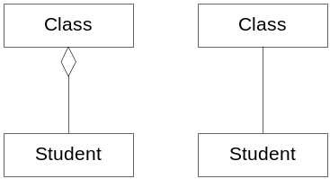
Aggregation versus Association
An aggregation is a complex object composed of other objects
An association is used when one object wants another object to perform a service for it.
  Associations are typically an interaction described by a verb.
Nonetheless, the dividing lines between these two relationships is not always clear.
Source: Matt Weisfeld, The Object-Oriented Thought Process (Sams, 2000), p. 180

Slide 108
Dependency
A dependency is a relationship between two elements where a change in one, affects the other.
  Also referred to as the "uses" relationship
Typically used to indicate that one class uses another, but the usage is not really an association.
  However, other relationships also imply a dependency relationship as well.
Source: Arlow and Neustadt, UML and the Unified Process (Addison-Wesley, 2002), p. 162-3.

Slide 109
Dependency
We generally try to reduce the dependencies between classes
One can almost never show all the dependencies in a class diagram.
  Instead, if the dependency is "interesting" or "relevant", then show it.

Slide 110
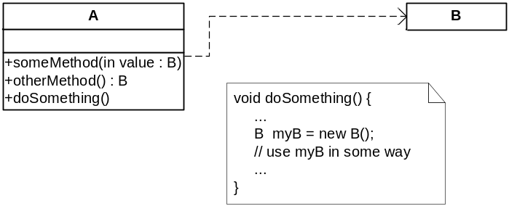
Dependency
Dependencies generated (in class diagrams) by:
  An operation of class A needs a parameter of class B
  An operation of class A returns a value of class B
  An operation of class A uses an object of class B somewhere in its implementation, but not as an attribute.

Slide 111
Dependency Example
How? Where?
fillWithGasoline($20)
Car
GasStation
+getGas(money)
There are several different ways that this dependency/uses relationship could be implemented
Source: Arthur Riel, Object-Orientec Deisgn Heuristics (Addison-Wesley, 1996).

Slide 112
Dependency Example
fillWithGasoline($20, aStation)
Car
getGas($20)
aStation: GasStation
1. Pass gas station object as parameter in original message
fillWithGasoline($20)
Car
Car
getGas($20)
Car
GlobalStation: GasStation
Car
2. All Car objects use a global gas station whose name we know

Slide 113
Dependency Example
GasStation gs = new GasStation();
gs.getGas(money);
fillWithGasoline($20)
Car
3. Car builds a Gas Station for the fill up

Slide 114
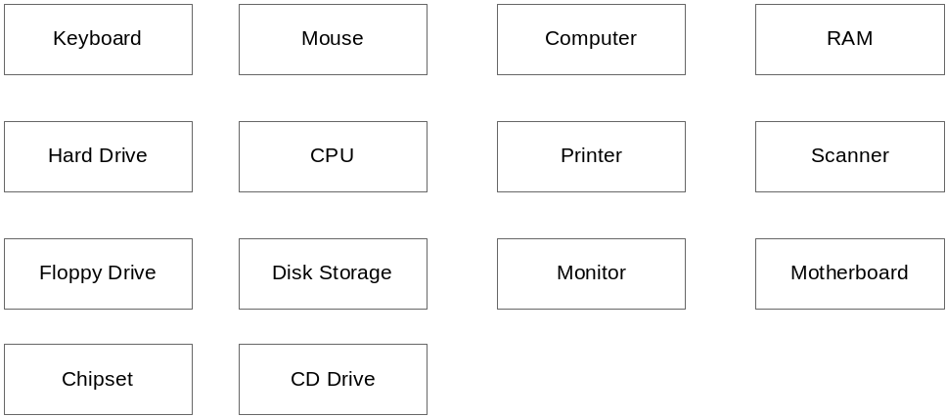
Relationship Exercise
Describe the relationships (association, aggregation, inheritance) between the following objects via a diagram (don’t worry about adornments).

Slide 115
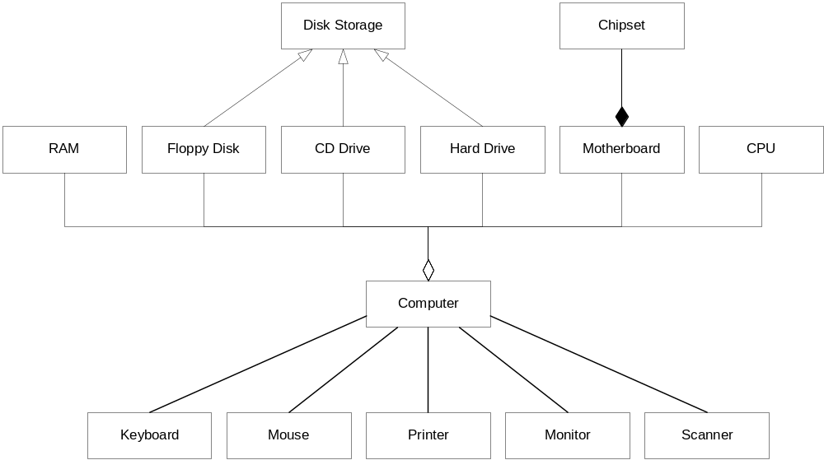
Relationship Exercise

